Slide 2
Topic – RDDs and Dataframes
ITECH2302 Big Data Management

Slide 3
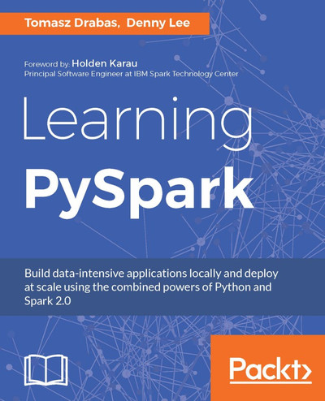
Chapter 2. Resilient Distributed Datasets
https://learning.oreilly.com/library/view/learning-pyspark/9781786463708/ch02.html

Slide 4
Chapter 3. DataFrames
https://learning.oreilly.com/library/view/learning-pyspark/9781786463708/ch03.html

Slide 5
PySpark Topic - Resilient Distributed Datasets
ITECH2302 Big Data Management

Slide 6
Overview
Internal workings of an RDD
Creating RDDs
Global versus local scopes
Transformations
Actions
Notes:
Internal workings of an RDD
Creating RDDs
Global versus local scopes
Transformations
Actions

Slide 7
Resilient Distributed Datasets
Resilient Distributed Datasets (RDDs) are a distributed collection of immutable JVM objects that allow you to perform calculations very quickly, and they are the backbone of Apache Spark.
As the name suggests, the dataset is distributed; it is split into chunks based on some key and distributed to executor nodes.
Doing so allows for running calculations against such datasets very quickly
RDDs keep track (log) of all the transformations applied to each chunk to speed up the computations and provide a fallback if things go wrong and that portion of the data is lost; in such cases, RDDs can recompute the data.
This data lineage is another line of defense against data loss, a complement to data replication.

Slide 8
Internal workings of an RDD
RDDs operate in parallel.
This is the strongest advantage of working in Spark:
Each transformation is executed in parallel for enormous increase in speed.
The transformations to the dataset are lazy.
Any transformation is only executed when an action on a dataset is called.
This helps Spark to optimize the execution.
Notes:
Internal workings of an RDD

Slide 9
Example
Count the occurrence of distinct values in a certain column.
Select those that start with an A.
Print the results to the screen.
First, we order Spark to map the values of A:
.map(lambda v: (v, 1))
Then select those records that start with an ’A’ :
.filter(lambda val: val.startswith('A'))
Reduce the dataset and add (in this example, count) the number of occurrences of each key:
.reduceByKey(operator.add)
All of these steps transform the dataset.
Second, we call the .collect() method to execute the steps.
This step is an action on our dataset - it finally counts the distinct elements of the dataset. In effect, the action might reverse the order of transformations and filter the data first before mapping, resulting in a smaller dataset being passed to the reducer.
Notes:
. For instance, consider the following very common steps that an analyst would normally do to get familiar with a dataset

Slide 10
Two ways to create an RDD in PySpark
.parallelize(...) a collection (list or an array of some elements):
data = sc.parallelize( [('Amber', 22), ('Alfred', 23), ('Skye',4), ('Albert', 12), ('Amber', 9)])

Slide 11
Two ways to create an RDD in PySpark
Reference a file (or files) located either locally or somewhere externally:
data_from_file = sc.textFile( '/Users/drabast/Documents/PySpark_Data/VS14MORT.txt.gz', 4)
The last parameter in sc.textFile(..., n) specifies the number of partitions the dataset is divided into.

Slide 12
Filesystems
Spark can read from a multitude of filesystems:
Local ones such as NTFS, FAT, or Mac OS Extended (HFS+),
Distributed filesystems such as HDFS, S3, Cassandra
Many others.

Slide 13
Data formats supported
Text, parquet, JSON, Hive tables, and data from relational databases can be read using a JDBC driver.
Spark can automatically work with compressed datasets (like Gzipped).
Depending on how the data is read, the object holding it will be represented slightly differently.
The data read from a file is represented as MapPartitionsRDD instead of ParallelCollectionRDD when we .paralellize(...) a collection.

Slide 14
Schemas
RDDs are schema-less data structures (unlike DataFrames).
Thus, parallelizing a dataset is perfectly fine with Spark when using RDDs:
data_heterogenous = sc.parallelize([ ('Ferrari', 'fast'), {'Porsche': 100000}, ['Spain','visited', 4504] ]).collect()
So, we can mix almost anything: a tuple, a dict, or a list
Once you .collect() the dataset (that is, run an action to bring it back to the driver) you can access the data in the object as you would normally do in Python:
data_heterogenous[1]['Porsche']
It will produce the following:
100000
The .collect() method returns all the elements of the RDD to the driver where it is serialized as a list.

Slide 15
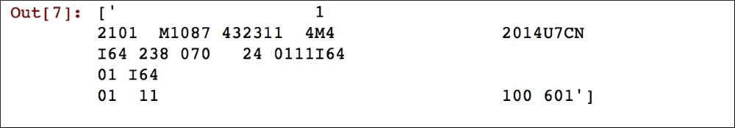
Reading from files
When you read from a text file, each row from the file forms an element of an RDD.
The data_from_file.take(1) command will produce the following output:

Slide 16
Global versus local scope
Need to get used to the inherent parallelism of Spark.
Spark can be run in two modes: Local and cluster.
When you run Spark locally your code might not differ to what you are currently used to with running Python: Changes would most likely be more syntactic than anything else but with an added twist that data and code can be copied between separate worker processes.
However, taking the same code and deploying it to a cluster requires understanding how Spark executes a job on the cluster.
Notes:
Global versus local scope
One of the things that you, as a prospective PySpark user,

Slide 17
Cluster mode
In the cluster mode, when a job is submitted for execution, the job is sent to the driver (or a master) node. The driver node creates a DAG for a job and decides which executor (or worker) nodes will run specific tasks.
The driver then instructs the workers to execute their tasks and return the results to the driver when done. Before that happens, however, the driver prepares each task's closure: A set of variables and methods present on the driver for the worker to execute its task on the RDD.
This set of variables and methods is inherently static within the executors' context, that is, each executor gets a copy of the variables and methods from the driver. If, when running the task, the executor alters these variables or overwrites the methods, it does so without affecting either other executors' copies or the variables and methods of the driver. This might lead to some unexpected behavior and runtime bugs that can sometimes be really hard to track down.
Notes:
Global versus local scope
One of the things that you, as a prospective PySpark user,

Slide 18
Transformations
Transformations shape your dataset. These include mapping, filtering, joining, and transcoding the values in your dataset. In this section, we will showcase some of the transformations available on RDDs.
Since RDDs are schema-less, it is assumed that you know the schema of the produced dataset.
Notes:
Transformations
Transformations shape your dataset. These include mapping, filtering, joining, and transcoding the values in your dataset. In this section, we will showcase some of the transformations available on RDDs.
Since RDDs are schema-less, in this section we assume you know the schema of the produced dataset.

Slide 19
.map(...) transformation
The method is applied to each element of the RDD,
e.g. create a new dataset that will convert year of death into a numeric value:
data_2014 = data_from_file_conv.map(lambda row: int(row[16]))
Running data_2014.take(10) will yield the following result

Slide 20
.filter(...) transformation
Allows you to select elements from your dataset that fit specified criteria. E.g., count how many people died in an accident in 2014:
data_filtered = data_from_file_conv.filter( lambda row: row[16] == '2014' and row[21] == '0') data_filtered.count()

Slide 21
.flatMap(...) transformation
Works similarly to .map(...), but it returns a flattened result instead of a list.
data_2014_flat = data_from_file_conv.flatMap(lambda row: (row[16], int(row[16]) + 1)) data_2014_flat.take(10)
Yields: the following output
.flatMap(...) can be used to filter out some malformed records when you need to parse your input.
Under the hood, .flatMap(...) treats each row as a list and then simply adds all the records together; by passing an empty list the malformed records is dropped.

Slide 22

.distinct(...) transformation
Returns a list of distinct values in a specified column.
Useful if you want to get to know your dataset or validate it.
e.g. check if the gender column contains only males and females:
distinct_gender = data_from_file_conv.map( lambda row: row[5]).distinct() distinct_gender.collect()
First, extract only the column that contains the gender.
Next, use .distinct() to select only the distinct values in the list.
Then use .collect() to return the print of the values on the screen.

Slide 23
.repartition(...) transformation
Repartitioning the dataset changes the number of partitions that the dataset is divided into.
Use sparingly and only when really necessary as it shuffles the data around, which in effect results in a significant performance overhead, e.g.:
rdd1 = rdd1.repartition(4) len(rdd1.glom().collect())
Prints out 4 as the new number of partitions.
.glom() , in contrast to .collect(), produces a list where each element is another list of all elements of the dataset present in a specified partition; the main list returned has as many elements as the number of partitions.

Slide 24
Actions
Actions, in contrast to transformations, execute the scheduled task on the dataset; once you have finished transforming your data you can execute your transformations.
This might contain no transformations (for example, .take(n) will just return n records from an RDD even if you did not do any transformations to it) or execute the whole chain of transformations.
Notes:
Actions

Slide 25
.take(...) method
This is most arguably the most useful (and used, such as the .map(...) method).
Preferred to .collect(...) as it only returns the n top rows from a single data partition in contrast to .collect(...), which returns the whole RDD. Especially important with large datasets:
data_first = data_from_file_conv.take(1)
If you want somewhat randomized records you can use .takeSample(...) instead, which takes three arguments:
whether the sampling should be with replacement,
number of records to return
seed to the pseudo-random numbers generator
data_take_sampled = data_from_file_conv.takeSample(False, 1, 667)

Slide 26
.collect(...) method
This method returns all the elements of the RDD to the driver. As we have just provided a caution about it, we will not repeat ourselves here.
The .reduce(...) method
The .reduce(...) method reduces the elements of an RDD using a specified method.
You can use it to sum the elements of your RDD:
rdd1.map(lambda row: row[1]).reduce(lambda x, y: x + y)
This will produce the sum of 15.
We first create a list of all the values of the rdd1 using the .map(...) transformation, and then use the .reduce(...) method to process the results. The reduce(...) method, on each partition, runs the summation method (here expressed as a lambda) and returns the sum to the driver node where the final aggregation takes place.

Slide 27
.count(...) method
Counts the number of elements in the RDD.
data_reduce.count()
The .count(...) method produces the same result as the following method, but it does not require moving the whole dataset to the driver:
len(data_reduce.collect()) # WRONG -- DON'T DO THIS!
If dataset is key-value, use .countByKey() to get the counts of distinct keys. data_key.countByKey().items()

Slide 28
.saveAsTextFile(...) method
Saves RDD to text files, each partition to a separate file:
data_key.saveAsTextFile( '/Users/drabast/Documents/PySpark_Data/data_key.txt’)
To read, parse it back as all the rows are treated as strings:
def parseInput(row):
import re
pattern = re.compile(r'\(\'([a-z])\', ([0-9])\)’)
row_split = pattern.split(row)
return (row_split[1], int(row_split[2]))
data_key_reread = sc.textFile( '/Users/drabast/Documents/PySpark_Data/data_key.txt’).map(parseInput)
data_key_reread.collect()
Notes:
The .saveAsTextFile(...) method

Slide 29
.foreach(...) method
Applies the same function to each element of the RDD in an iterative way
In contrast to .map(..), the .foreach(...) method applies a defined function to each record in a one-by-one fashion.
Useful when you want to save the data to a database that is not natively supported by PySpark.
Notes:
The .foreach(...) method

Slide 30
Summary
RDDs are the backbone of Spark;
Schema-less data structures - most fundamental data structures in Spark.
Create RDDs from text files, by .parallelize(...) method as well as by reading data from text files.
Transformations in Spark are lazy - they are only applied when an action is called.
Most commonly used transformations and actions;
PySpark documentation contains many more http://spark.apache.org/docs/latest/api/python/pyspark.html#pyspark.RDD

Slide 31
DataFrames

Slide 32
Overview
Python to RDD communications
Spark's Catalyst Optimizer
Speeding up PySpark with DataFrames
Creating DataFrames
Simple DataFrame queries
Interoperating with RDDs
Querying with the DataFrame API
Querying with Spark SQL
Using DataFrames for an on-time flight performance

Slide 33
Dataframes
A DataFrame is an immutable distributed collection of data that is organized into named columns analogous to a table in a relational database.
Introduced as an experimental feature within Apache Spark 1.0 as SchemaRDD, renamed to DataFrames as part of the Apache Spark 1.3 release.
Spark DataFrame is similar to Python Pandas DataFrame or R DataFrame, in that it allows users to easily work with structured data (for example, data tables); but there are some differences

Slide 34
Dataframes
By imposing a structure onto a distributed collection of data, this allows Spark users to query structured data in Spark SQL or using expression methods (instead of lambdas).
By structuring data, this allows the Apache Spark engine – specifically, the Catalyst Optimizer – to significantly improve the performance of Spark queries.
In earlier APIs of Spark (that is, RDDs), executing queries in Python could be significantly slower due to communication overhead between the Java JVM and Py4J.

Slide 35
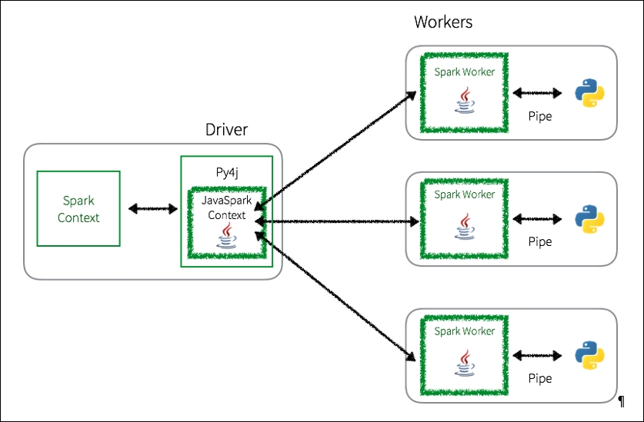
Python to RDD communications
Whenever a PySpark program is executed using RDDs, there is a potentially large overhead to execute the job.
In the PySpark driver, the Spark Context uses Py4j to launch a JVM using the JavaSparkContext.
Any RDD transformations are initially mapped to PythonRDD objects in Java.
Once these tasks are pushed out to the Spark Worker(s), PythonRDD objects launch Python subprocesses using pipes to send both code and data to be processed within Python

Slide 36
Python to RDD communications
While this approach allows PySpark to distribute the processing of the data to multiple Python subprocesses on multiple workers, there is a lot of context switching and communications overhead between Python and the JVM.

Slide 37
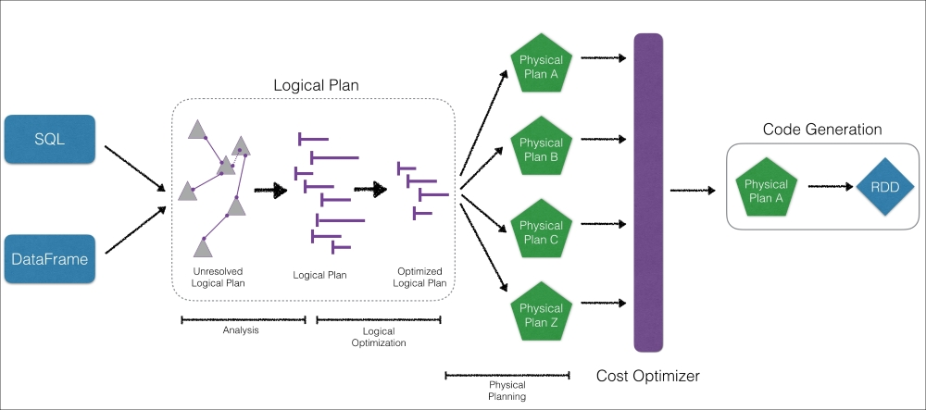
Catalyst Optimizer
Notes:
One of the primary reasons the Spark SQL engine is so fast is because of the Catalyst Optimizer.
similar to the logical/physical planner and cost model/cost-based optimization of a relational database management system (RDBMS):
As opposed to immediately processing the query, the Spark engine's Catalyst Optimizer compiles and optimizes a logical plan and has a cost optimizer that determines the most efficient physical plan generated.

Slide 38
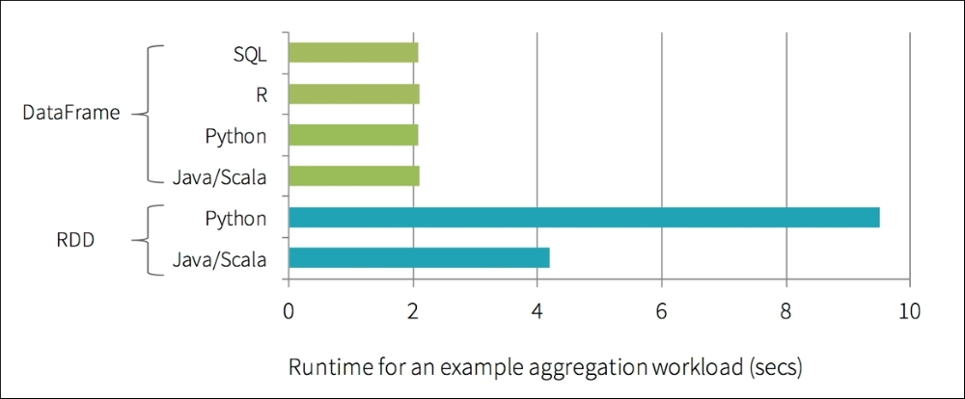
Speeding up PySpark with DataFrames
The significance of DataFrames and the Catalyst Optimizer (and Project Tungsten) is the increase in performance of PySpark queries when compared to non-optimized RDD queries.
Notes:
Prior to the introduction of DataFrames, Python query speeds were often twice as slow as the same Scala queries using RDD. Typically, this slowdown in query performance was due to the communications overhead between Python and the JVM
With DataFrames, not only was there a significant improvement in Python performance, there is now performance parity between Python, Scala, SQL, and R.

Slide 39
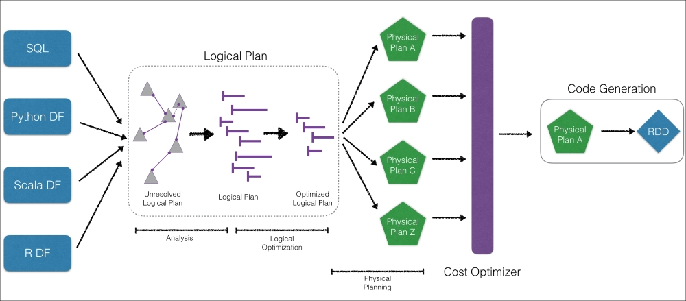
Speeding up
Python can take advantage of the performance optimizations in Spark even while the codebase for the Catalyst Optimizer is written in Scala.
Basically, it is a Python wrapper of approximately 2,000 lines of code that allows PySpark DataFrame queries to be significantly faster.
Altogether, Python DataFrames (as well as SQL, Scala DataFrames, and R DataFrames) are all able to make use of the Catalyst Optimizer

Slide 40
Creating DataFrames
import data using SparkSession (or calling spark in the PySpark shell).
Also import data into your local file system, Hadoop Distributed File System (HDFS), or other cloud storage systems (for example, S3 or WASB).

Slide 41
Create DataFrame from JSON
Generate stringJSONRDD RDD
stringJSONRDD = sc.parallelize((""" { "id": "123", "name": "Katie", "age": 19, "eyeColor": "brown" }""", """{ "id": "234", "name": "Michael", "age": 22, "eyeColor": "green" }""", """{ "id": "345", "name": "Simone", "age": 23, "eyeColor": "blue" }""") )
convert this into a DataFrame by using SparkSession read.json method - spark.read.json(...)).
Create a temporary table using .createOrReplaceTempView

Slide 42
Creating a DataFrame
swimmersJSON = spark.read.json(stringJSONRDD)
Creating temporary table:
swimmersJSON.createOrReplaceTempView("swimmersJSON")
Many RDD operations are transformations, which are not executed until an action operation is executed.
the sc.parallelize is a transformation that is executed when converting from an RDD to a DataFrame by using spark.read.json.

Slide 43
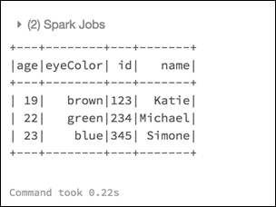
Simple DataFrame queries
Now able to run the DataFrame API, as well as SQL queries against it.
e.g. show all the rows within the DataFrame.
# DataFrame API
swimmersJSON.show()

Slide 44
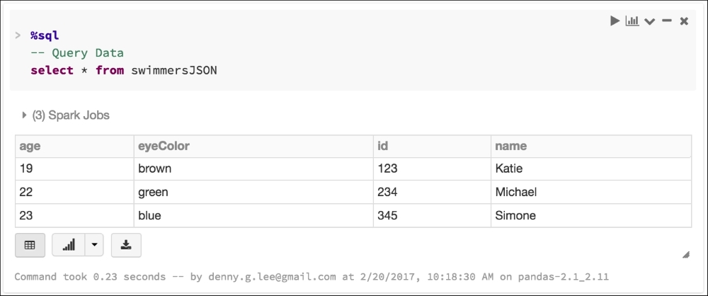
SQL query
spark.sql("select * from swimmersJSON").collect()
Notes:
We are using the .collect() method, which returns all the records as a list of Row objects. Note that you can use either the collect() or show() method for both DataFrames and SQL queries. Just make sure that if you use .collect(), this is for a small DataFrame, since it will return all of the rows in the DataFrame and move them back from the executors to the driver. You can instead use take(<n>) or show(<n>), which allow you to limit the number of rows returned by specifying <n>:

Slide 45
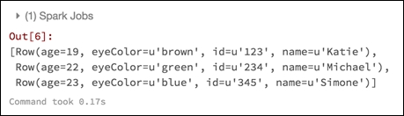
.collect()
Returns all the records as a list of Row objects.
Can use either the collect() or show() method for both DataFrames and SQL queries.
.collect() will return all of the rows in the DataFrame and move them back from the executors to the driver.
take(<n>) or show(<n>), allow you to limit the number of rows returned by specifying <n>

Slide 46
End of the lecture
Questions, comments
Notes:
46

